Slide 1
Lecture 4
Informed Search
Yaohang Li
Department of Computer Science
ODU
Reading for Next Class:
Chapter 3, Russell and Norvig

Slide 2
Review
Last Class
  Implementation of Blind Search Algorithm
    Breadth-first search
    Depth-first search
    Uniform-cost search
  Analysis of Blind Search Algorithm
This Class
  Discussion of Assignment 1
  Heuristic Search
Next Class
  Local Search

Slide 3
Heuristic Search
Best-first Search
  A node is selected for expansion based on an evaluation function, f(n)
  The node with the lowest evaluation is selected
  Implemented using a priority queue
Best-first Search is not an accurate name
  The node may not be actually the best
  It is “Seemingly Best”
Heuristic Function
  h(n) = estimated cost of the cheapest path from node n to a goal node

Slide 4
Greedy Best-First Search
Strategy
  Try to expand the node that is closest to the goal
  The node is likely to lead to a solution quickly
  Evaluation function is the heuristic function
    f(n)=h(n)
Analysis
  Similar to the DFS
  Keep track of the path from the root to the current node

Slide 5
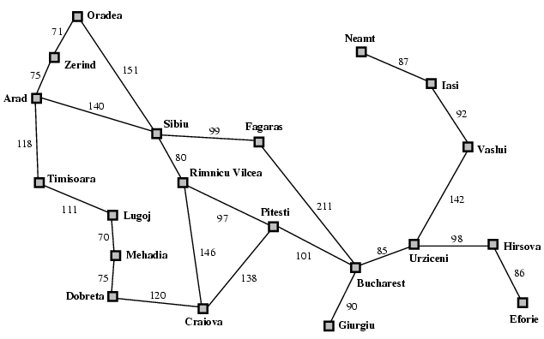
Example: Route Finding

Slide 6
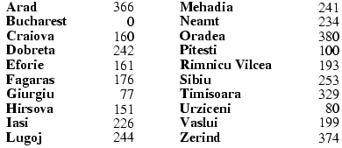
Example: Route Finding
Heuristic Function
Heuristic Function
  Using the straight-line distance
  We need to know the straight-line distance to the goal state
  Suppose our goal is Bucharest

Slide 7
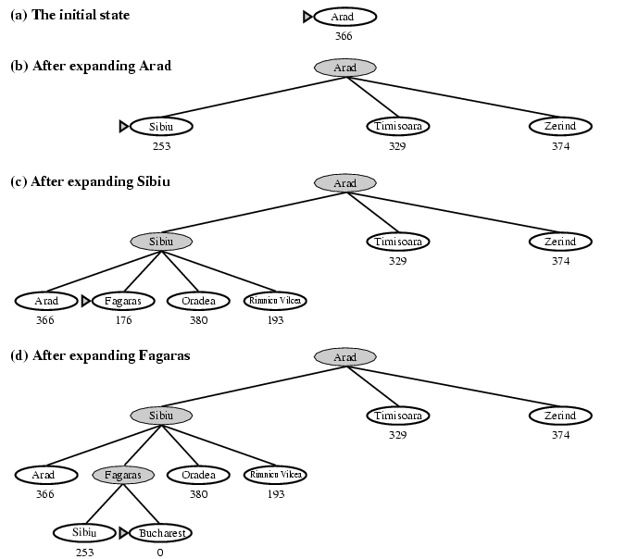
Stages in a Greedy Best-First

Slide 8
Analysis of Greedy Best-first Search
How about from Iasi to Fagaras in our example?
Requirement of Greedy Best-first Search
  We need additional information
  Straight line distance in our route-finding example
Discussion
  Heuristic may cause unnecessary nodes to be expanded
  May be in an infinite path
  Similar to DFS
    Incomplete
    Not Optimal
    Worse case time and space complexity: O(b^{m})
Conclusion
  Good Heuristic is the Key
    The complexity can be reduced substantially
  Bad Heuristic can make the problem worse

Slide 9
Another Example of Greedy Best-First Search
8-puzzle
Develop a useful heuristic function

Slide 10
Heuristic Function
Function h(N) that estimates the cost of the cheapest path from node N to goal node.
Example: 8-puzzle
5
8
1
2
3
h(N) = number of misplaced tiles
= 6
4
2
1
4
5
6
7
3
6
7
8
N
goal

Slide 11
Heuristic Function
Function h(N) that estimates the cost of the cheapest path from node N to goal node.
Example: 8-puzzle
5
8
1
2
3
h(N) = sum of the distances of
every tile to its goal position
= 2 + 3 + 0 + 1 + 3 + 0 + 3 + 1
= 13
4
2
1
4
5
6
7
3
6
7
8
N
goal

Slide 12
8-Puzzle
f(N) = h(N) = number of misplaced tiles
3
3
4
5
3
4
2
4
2
1
3
3
0
4
5
4

Slide 13
8-Puzzle
f(N) = h(N) = Σ distances of tiles to goal
6
5
2
5
2
1
4
3
0
4
6
5

Slide 14
Example of a Better Evaluation Function
f(N) = (sum of distances of each tile to its goal)
+ 3 x (sum of score functions for each tile)
where score function for a non-central tile is 2 if it is
not followed by the correct tile in clockwise order
and 0 otherwise
5
8
1
2
3
f(N) = 2 + 3 + 0 + 1 + 3 + 0 + 3 + 1
3x(2 + 2 + 2 + 2 + 2 + 0 + 2)
= 49
4
2
1
4
5
6
7
3
6
7
8
N
goal

Slide 15
Greedy Algorithms
Step-by-step algorithms
Sometimes works well for optimization problems
A greedy algorithm works in phases. At each phase:
  You take the best you can get right now, without regard for future consequences
  You hope that by choosing a local optimum at each step, you will end up at a global optimum

Slide 16
Example: Counting money
Suppose you want to count out a certain amount of money, using the fewest possible bills and coins
A greedy algorithm would do this would be:
At each step, take the largest possible bill or coin that does not overshoot
  Example: To make $6.39, you can choose:
    a $5 bill
    a $1 bill, to make $6
    a 25¢ coin, to make $6.25
    A 10¢ coin, to make $6.35
    four 1¢ coins, to make $6.39
For US money, the greedy algorithm always gives the optimum solution

Slide 17
A failure of the greedy algorithm
In some (fictional) monetary system, “krons” come in 1 kron, 7 kron, and 10 kron coins
Using a greedy algorithm to count out 15 krons, you would get
  A 10 kron piece
  Five 1 kron pieces, for a total of 15 krons
  This requires six coins
A better solution would be to use two 7 kron pieces and one 1 kron piece
  This only requires three coins
The greedy algorithm results in a solution, but not in an optimal solution

Slide 18
Uniform Cost Search vs. Greedy Best First Search
Same Strategy
  Implementation
    A priority queue
Difference
  Uniform Cost Search
    Cares for the path cost
    Expand nodes with the lowest path cost
  Greedy Best First Search
    Cares for the heuristic
    Expand nodes with the lowest heuristic value
Thinking
  Can we combine this two search strategies?
  A* Search

Slide 19
A* Search
Goal
  Minimizing the total estimated solution cost
Evaluation function
  f(n)
    Estimated cost of the cheapest solution through n
    f(n)=g(n)+h(n)
  g(n)
    History
    Gives the path cost from the start node to node n
  h(n)
    Estimated cost of the cheapest path from n to the goal
    Heuristic function

Slide 20
Example: Route Finding
A* Search
Heuristic Function
  Using the straight-line distance
Path Cost Function
  Using the path cost from the graph

Slide 21
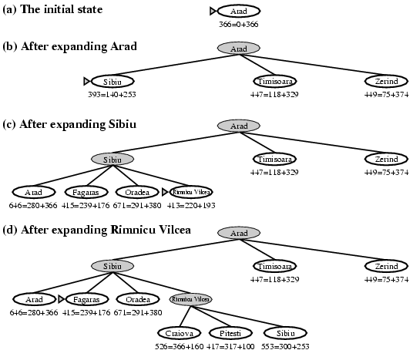
Progress in A* Search

Slide 22
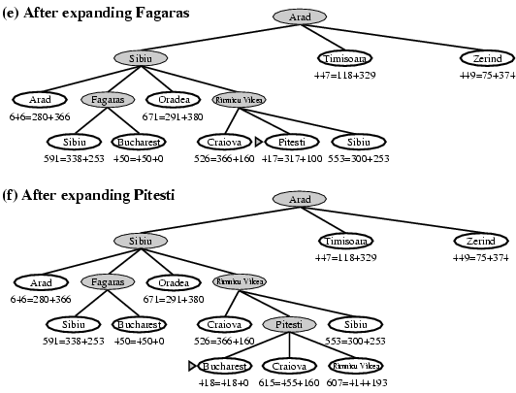
Progress in A* Search (Continue)

Slide 23
Analysis of A* Search
Completeness and Optimality
  Provided that the heuristic function h(n) satisfies certain conditions, A* search is both complete and optimal
  A* is optimal if h(n) is an admissible heuristic
    Admissible heuristic
      Provided that h(n) never overestimates the cost to reach the goal
      Nature optimistic
        Thinking the cost of solving the problem is less than it actually is
Drawback
  Space requirement
    Keep all generated nodes in memory
    Easy to run out of memory
    Not practical for many large-scale problems

Slide 24
Summary
Heuristics and Heuristic Functions
Heuristic Algorithm
Greedy Algorithm
A* Algorithm

Slide 25
What I want you to do
Review Chapter 3
Work on your assignment
Organize your project team

